Slide 1

CREATING A BLOCKCHAIN
This Photo by Unknown Author is licensed under CC BY-SA
By James Neil

Slide 2

Intro to Blockchain:
A blockchain is a decentralized, distributed and public digital ledger that is used to record transactions across many computers so that any involved record cannot be altered retroactively, without the alteration of all subsequent blocks.
This Photo by Unknown Author is licensed under CC BY

Slide 3
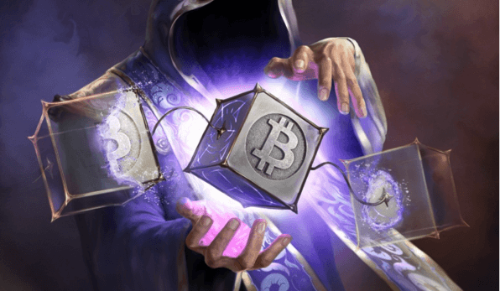
Key Jargon to Know:
Node- A node is a device(computer) on a blockchain network, that is in essence the foundation of the technology, allowing it to function and survive. Each cryptocurrency has its own nodes, maintaining the transaction records of that particular token.
Hash- A cryptographic hash function is a hash function which takes an input (or 'message') and returns a fixed-size string of bytes. The string is called the 'hash value', 'message digest', 'digital fingerprint', 'digest' or 'checksum’.
Genesis Block- A genesis block is the first block of a block chain.
This Photo by Unknown Author is licensed under CC BY-ND

Slide 4
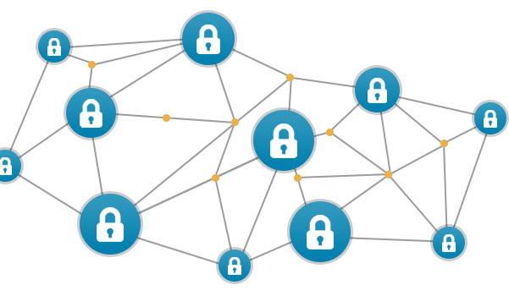
Jargon Cont…
Block- Blocks are files where data pertaining to a blockchain network is permanently recorded. A block can record some or all of the most recent blockchain transactions that have not yet entered any prior blocks. Thus a block is like a page of a ledger or record book.
Consensus Mechanism - is a fault-tolerant mechanism that is used in computer and blockchain systems to achieve the necessary agreement on a single data value or a single state of the network among distributed processes or multi-agent systems. i.e.- proof of work(PoW), proof of Stake(PoS).
This Photo by Unknown Author is licensed under CC BY-NC-ND

Slide 5

My Blockchain
Transactions, Validation, and updating system state at its core, a blockchain is a distributed database with a set of rules for verifying new additions to the database. We’ll start off by tracking the accounts of two imaginary people: Alice and Bob, who will trade virtual money with each other.
We’ll need to create a transaction pool of incoming transactions, validate those transactions, and make them into a block.
We’ll be using a hash function to create a ‘fingerprint’ (hash) for each of our transactions- this hash function links each of our blocks to each other. To make this easier to use, we’ll define a helper function to wrap the python hash function that we’re using.
This Photo by Unknown Author is licensed under CC BY-NC-ND

Slide 6
Project cont…
Next, we want to create a function to generate exchanges between Alice and Bob. We’ll indicate withdrawals with negative numbers, and deposits with positive numbers. We’ll construct our transactions to always be between the two users of our system, and make sure that the deposit is the same magnitude as the withdrawal- i.e. that we’re neither creating nor destroying money.
This Photo by Unknown Author is licensed under CC BY-NC-ND

Slide 7

Let’s take a look at the jupyter notebook!!!
This Photo by Unknown Author is licensed under CC BY-SA-NC

Slide 8

And that’s it!!!!!
Thank you for listening to my project!!!!!
This Photo by Unknown Author is licensed under CC BY-ND

